Slide 1
D-311
Unit 0: Introduction
Notes:
Greet and Orient Students

Slide 2
Objectives
Introduce Instructors, course coordinator and students.
Discuss administrative and logistics concerns.
Present the course objectives.

Slide 3
Objectives
Explain the course design.
Explain the course evaluation system.
Review pre-course work and discussion course expectations.

Slide 4
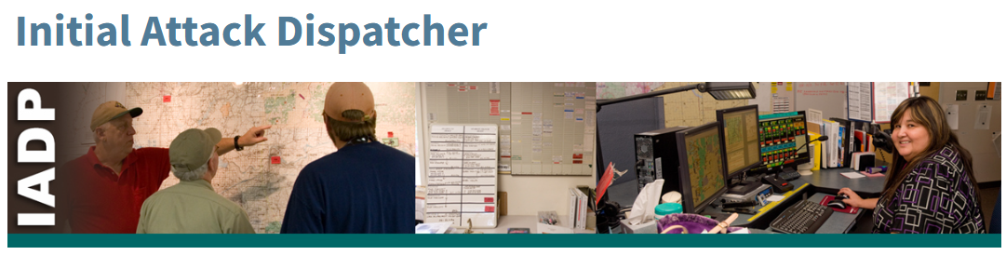
Incident Position Standards Alignment
The Initial Attack Dispatcher (IADP) is responsible for mobilizing preplanned response resources to wildfires and other incidents. The IADP reports to the Dispatch Center Manager and works in the dispatch functional area.
IADP Incident Position Description
IADP Qualification Requirements

Slide 5
Introductions
Name?
Job Title?
Where you work?
Notes:
Introductions: Name, Job Title/Position, Where you work/Location?, Pick something unique (Hobby/Highschool Mascot/Vacation destination, etc. )

Slide 6
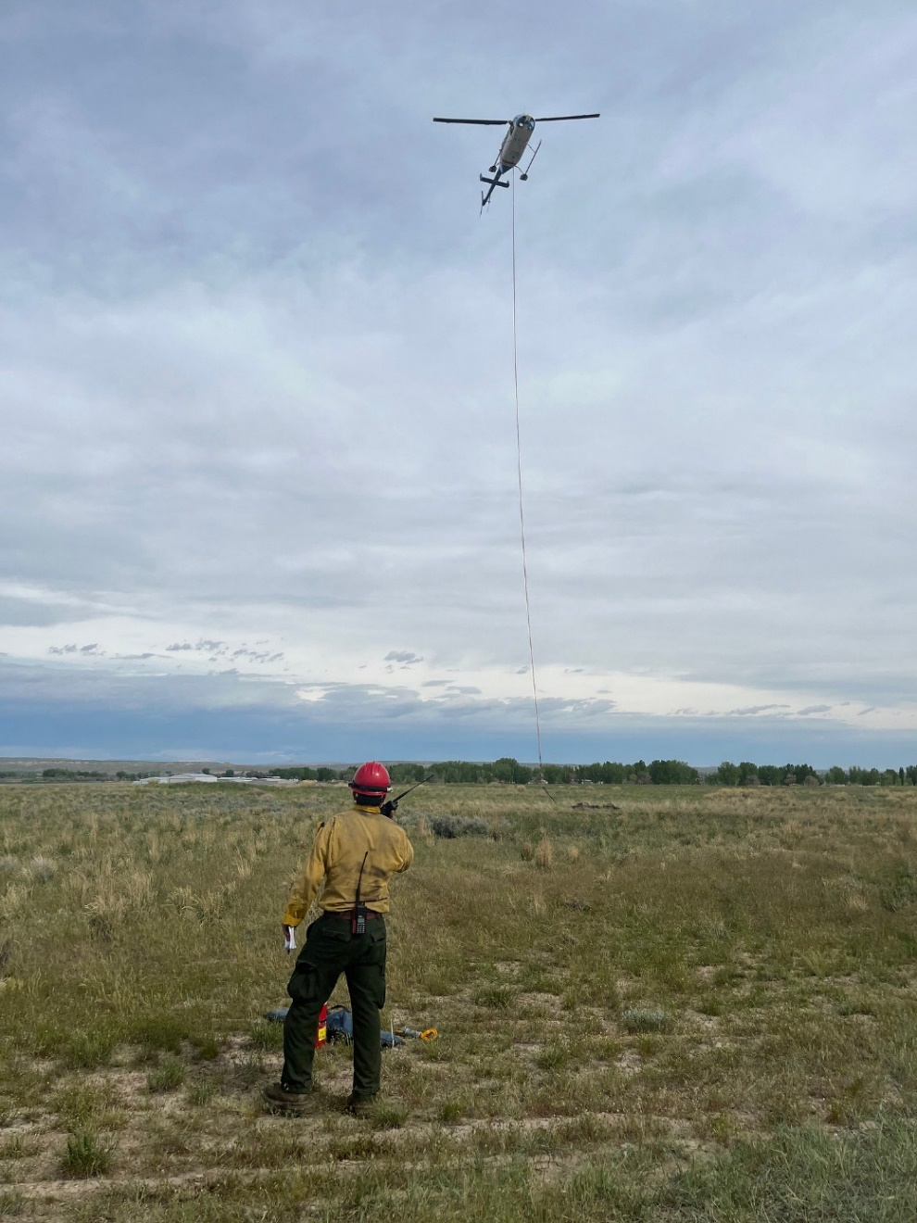
Group Activity

Slide 7
Unit Overview
Unit 1: Decision Making and Situational Awareness
Unit 2: Introduction to LE&I
Unit 3: Radios
Unit 4: Intelligence
Unit 5: IA Dispatch Environment, General Processes, and WildCAD-E Introduction
Unit 6: Incident Business Support

Slide 8
Unit Overview
Unit 7: Maps
Unit 8: Basic Initial Attack Aircraft
Unit 9: Daily Duties
Unit 10: Health and Safety
Unit 11: Cadre Simulation
Unit 12: Student Simulation #1
Unit 13: Student Simulation #2

